Slide 1
Analysis on CUSTOMER PERFORMNACE
By [SAFEH EMMANUELA MANJOAH and SOH DAVID FON]
Hort 1.0 Traitz Tech 2025

Slide 2
1.OVER VIEW OF WORK
Hello everyone, welcome to our presentation. Today, we'll be looking at what we've learned from our customer dataset. This will help us better understand our customers and make good decisions for our business.

Slide 3
2. Problems
Declining customer satisfaction and loyalty are significant concerns for business resulting in increased customer churn and negative performance and developing targeted strategies to improve satisfaction, reduce churn, and increase loyalty are crucial for business software

Slide 4
Why this problem?
Revenue impact: customer churn can result in significant revenue lossess, impacting business growth and profitability
Competitive advantage: in todays competitive market, customer satisfaction are loyalty are key differentiators that can set businesses apart
Growth and expansion: improving customer performance can provide more valuable insights for business grow and expansion, such as identifying new markets for oppurtunities.
Increased customer satisfaction: customers satisactions are rising, and businwesses must adapt to meet these expectations to remain competitive

Slide 5
SOLUTONS
DATA DRIVEN ANALYSIS:
-conduct customer feedback analysis: collect and analyze customer feed back from various sources(e.g. surveys, reviews, social media).
Identify key drivers of dissatisfaction: use statistical models and machine learning algorithms to identify the primary drivers of customer dissatisfaction
Develop Targetted improvement strategies to address the key drivers of dissatisfaction

Slide 6
5. Objective of analysis
The main goal of this analysis is to learn more about our customers, find ways to improve our marketing, keep our customers happy, and serve them better, so we can grow our business.

Slide 7
6. Data Overview
The dataset consists of the following columns:
Customer ID: A unique identifier for each customer.
Region: Geographic region where the customer resides.
Purchases: The number of purchases made by the customer.
Total Spent: The total amount spent by the customer.
Satisfaction Score: A score reflecting the customer's satisfaction level.
Repeat Customer: Indicates if the customer is a repeat buyer or not.

Slide 8
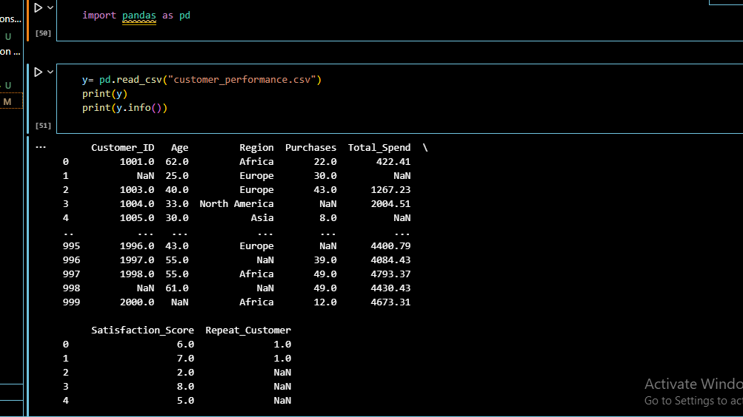
7.DATA SET OVER VIEW
We have to load the data set given by the formula y= pd.read_csv("customer_performance.csv")
print(y)
.this will allow the file to be read

Slide 9
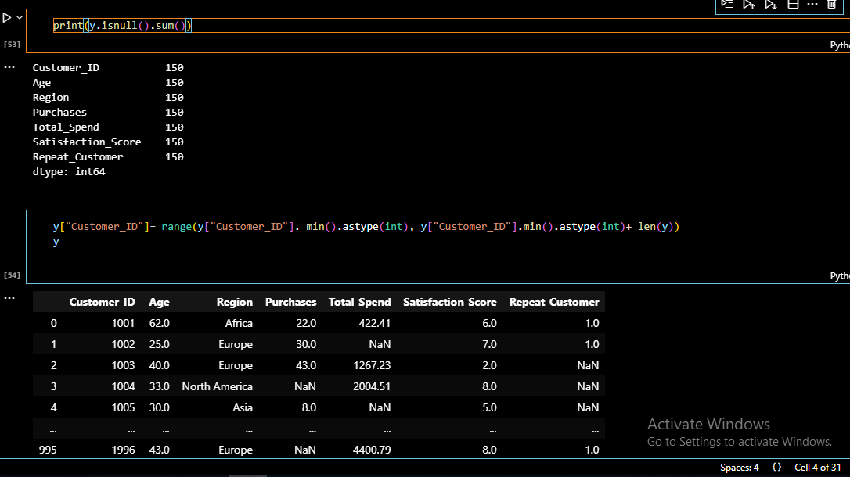
3. Filling the fist missing values in the first column with the expected value to be there using the formula y["Customer_ID"]= range(y["Customer_ID"]. min().astype(int), y["Customer_ID"].min().astype(int)+ len(y))
we then now fill the remaining missing values in the respective columns using either:
Mean
Mode
Median
Depending on the type of data we have(numerical and Categorical data)

Slide 10
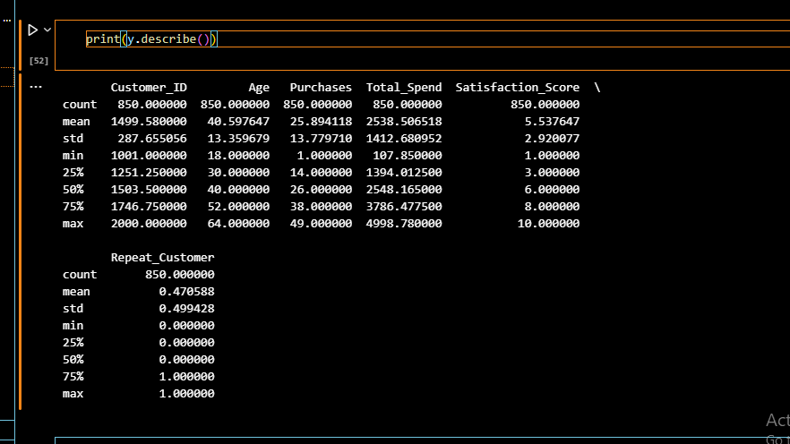
Data cleaning process
We use the formula print(y.describe()) to describe or summarize the data set were working with
Next thing we do is to look for missing values using the formula print(y.isnull().sum()) which prints out the sum of all mjssing values

Slide 11
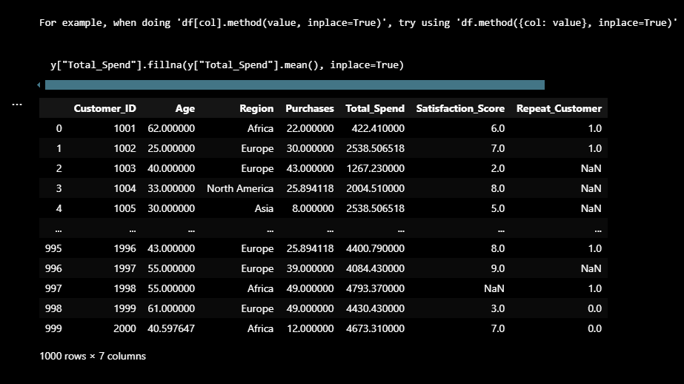
We used the mean because it is a numerical column and preserves the continuity and distribution of the financial data

Slide 12
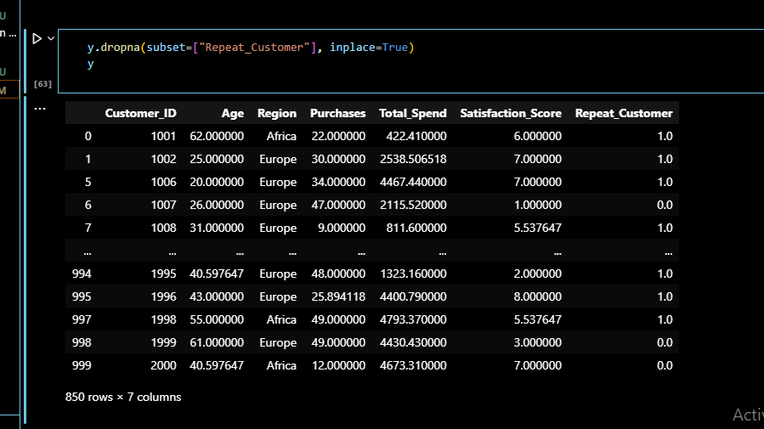
Next , I dropped the empty cells in the “Repeat –Customer” column because they didn't indicate whether the customer was a repeat customer (1) or not (0), making it impossible to accurately analyze customer behavior.

Slide 13
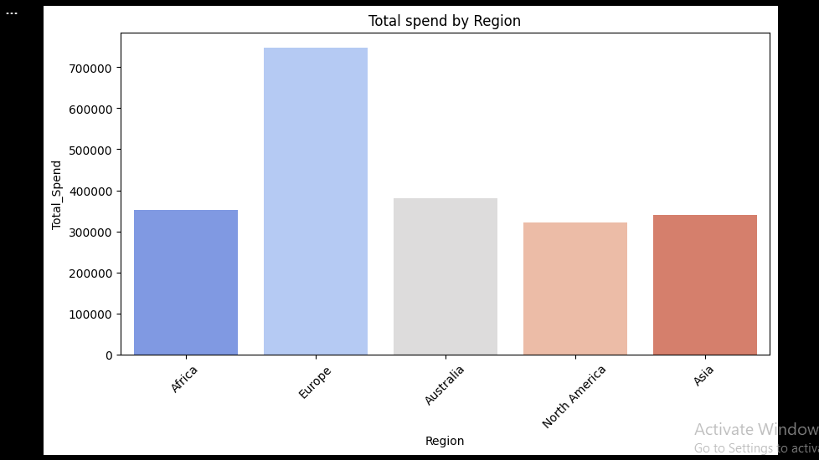
DATA VISUALIZATION
- Graph of total spend by region
Explanation : To compare spending trends by region
From the graph, Europe has the highest satisfaction scores, while Africa has the lowest. This suggests that certain regions may require better customer service, improved products, or come up with marketing strategies to improve satisfaction.

Slide 14
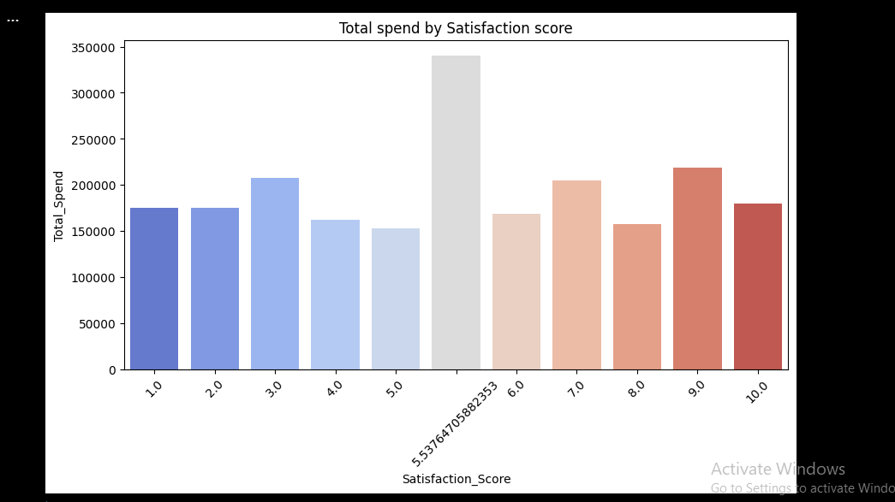
- Graph of total spend by satisfaction score
Explanation: To analyze if satisfied customers spend more
Based on the graph , it appears that higher customer satisfaction leads to greater total spending

Slide 15
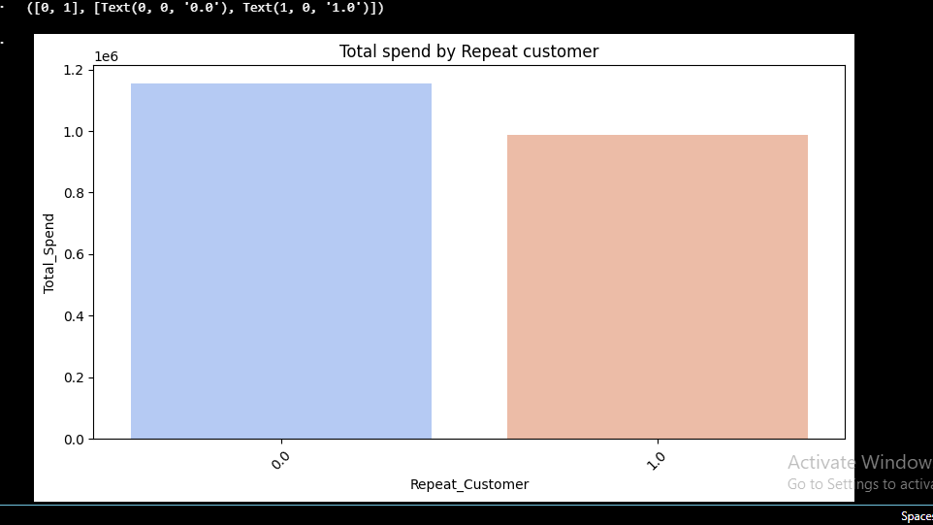
- Graph of total spend by Repeat Customer
Explanation: To see if repeat customers spend more
Based on our graph, repeat customers have lower total spending

Slide 16
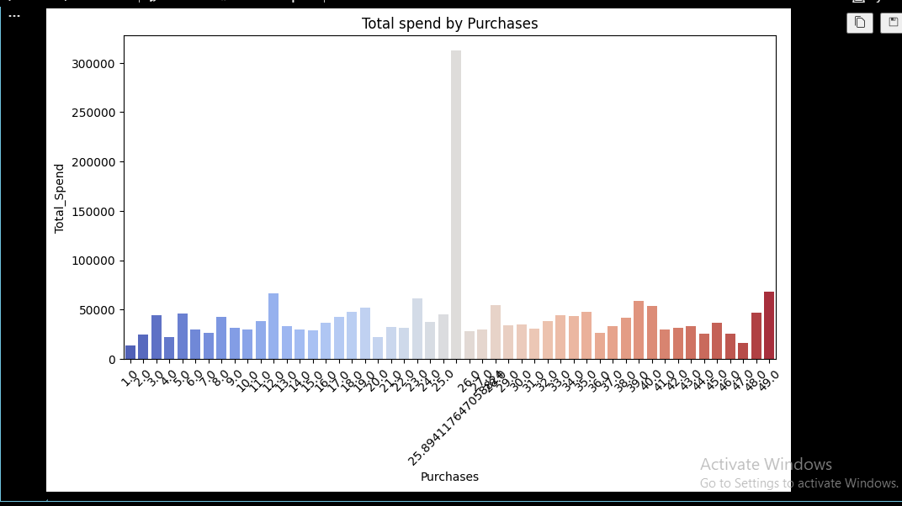
- Graph of total spend by purchases
Explanation: To check if higher purchases lead to higher spending
From the graph, it shows that as the number of purchases increases, total spending also tends to rise, especially toward the right side of the graph where higher purchase counts correspond with greater spending.

Slide 17
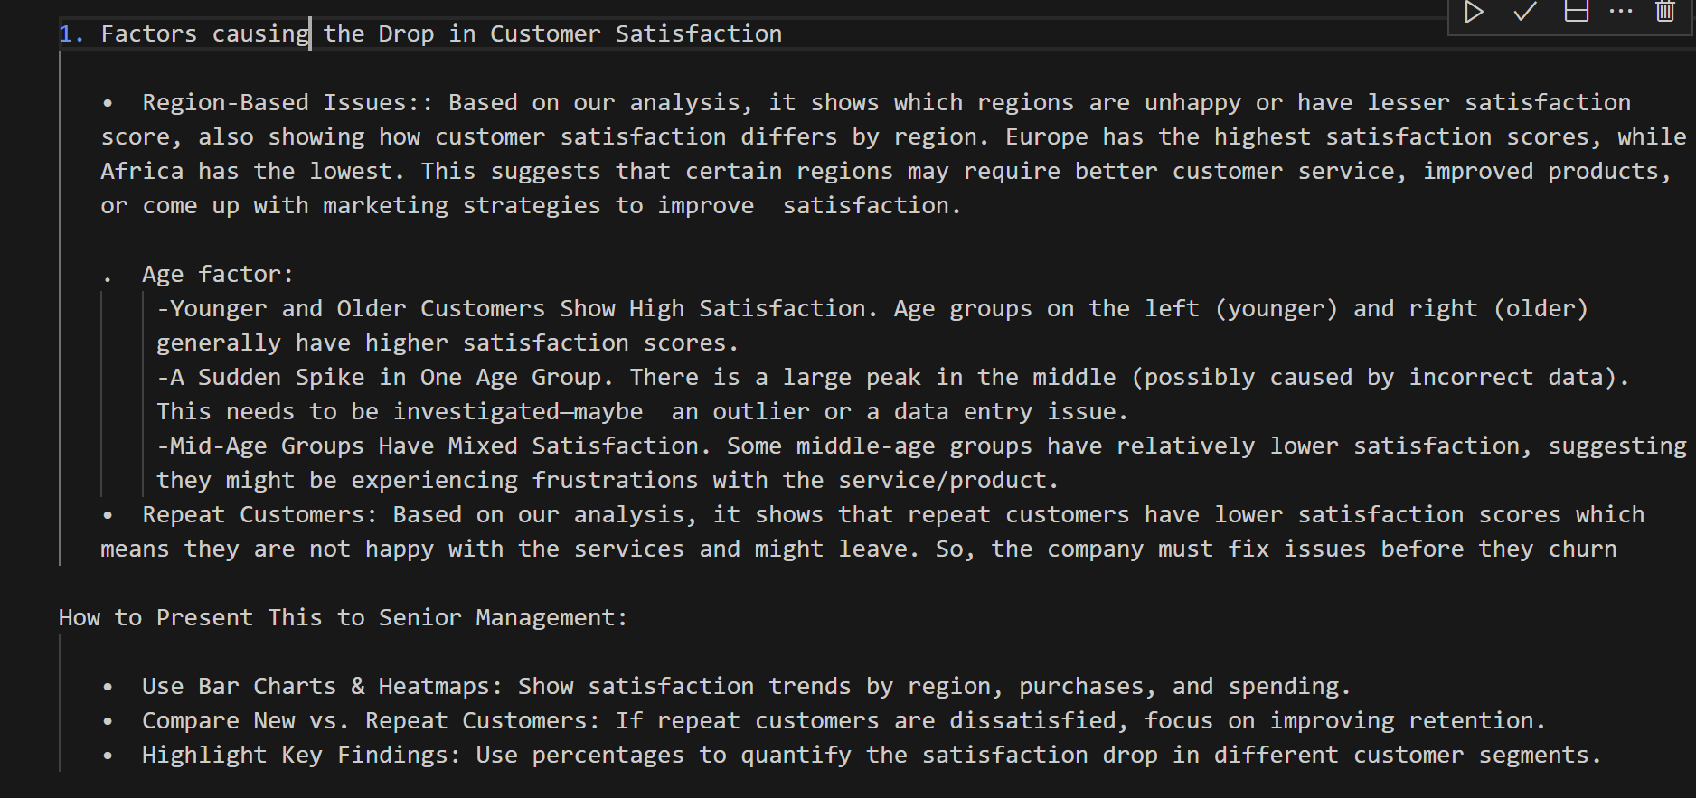
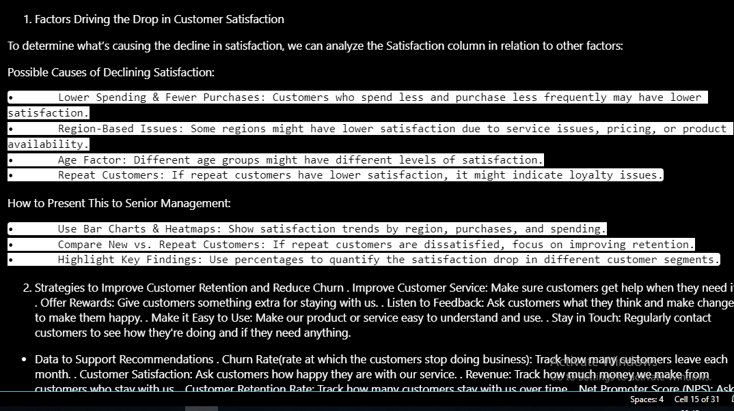
8.ANSWERING REAL WORLD QUESTIONS

Slide 18
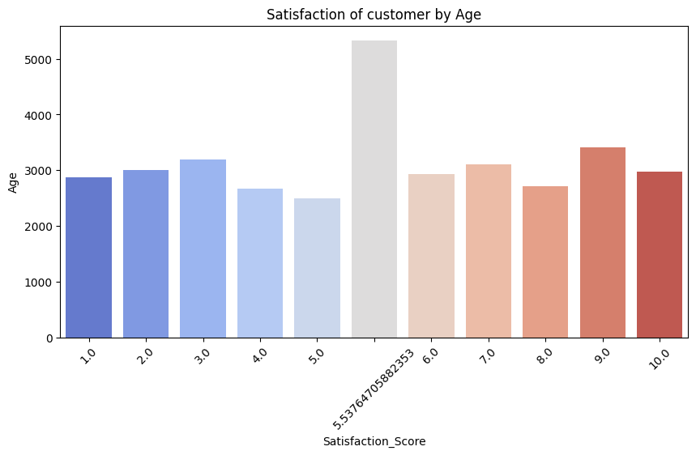
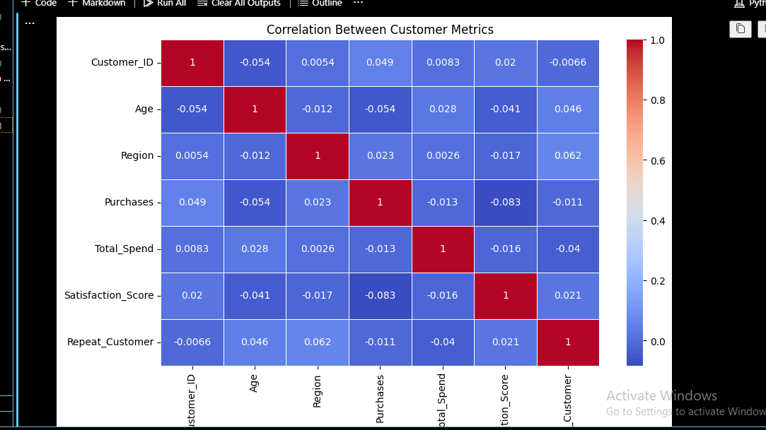
- Graph of satisfaction score by Age
Explanation: Younger and Older Customers Show High Satisfaction . Age groups on the left (younger) and right (older) generally have higher satisfaction scores . A Sudden Spike in One Age Group : There is a large peak in the middle (possibly caused by incorrect data). Mid-Age Groups Have Mixed Satisfaction : Some middle-age groups have relatively lower satisfaction, suggesting they might be experiencing frustrations with the service/product.

Slide 19
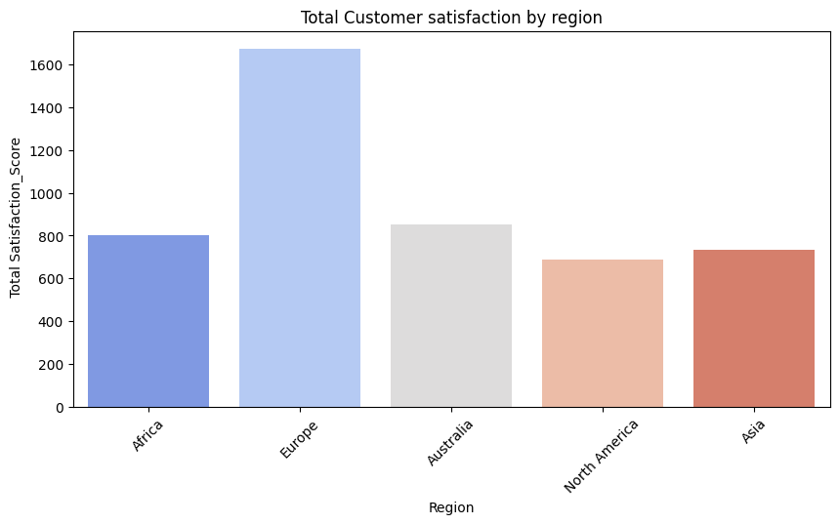
- Graph satisfaction score by Region
Explanation: Bar chat shows which regions are unhappy or have lesser satisfaction score.
This graph highlights how customer satisfaction differs by region. Europe has the highest satisfaction scores, while Africa has the lowest. This suggests that certain regions may require better customer service, improved products, or come up with marketing strategies to improve satisfaction.

Slide 20
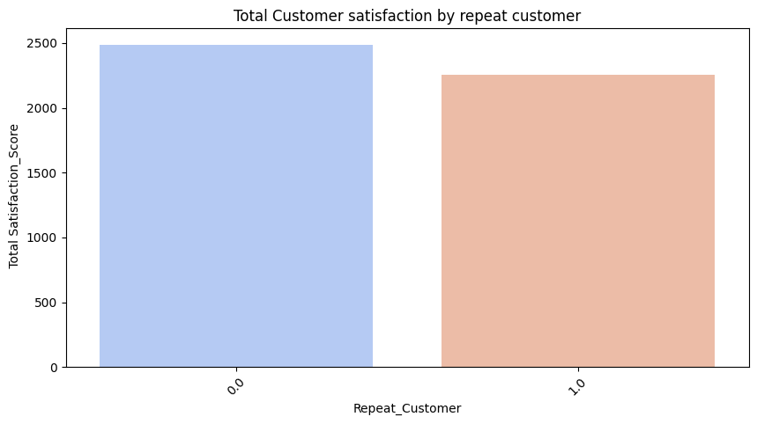
- Graph of satisfaction score by repeat customer
Explanation: From the graph, it shows that repeat customers have lower satisfaction scores which means they are not happy with the services and might leave.

Slide 21
- Heatmap (Correlations Between Customer Metrics)
Explanation: This graph helps us to understand which factors strongly impact satisfaction
From the graph:
1.Total_Spend and Purchases have a moderate correlation with Satisfaction_Score. This means that customers who spend more or make more purchases tend to have higher satisfaction.
2.Repeat_Customer might also show some correlation, indicating that returning customers could be more satisfied than new ones.
3.Age and Region appear to have weaker correlations, meaning they have less direct impact on customer satisfaction.

Slide 22
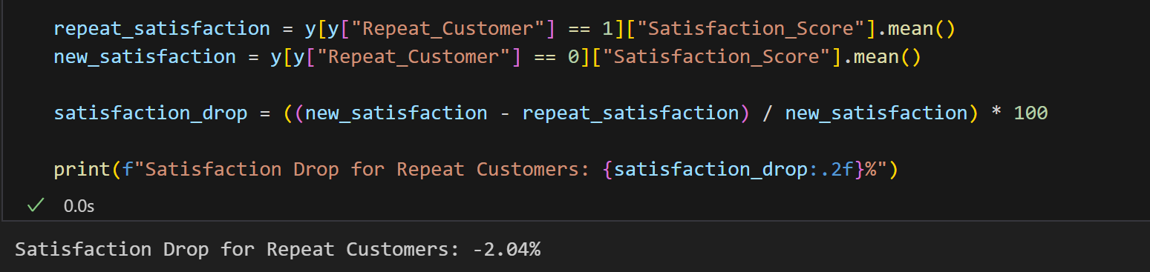
Explanation: A code to

Slide 23
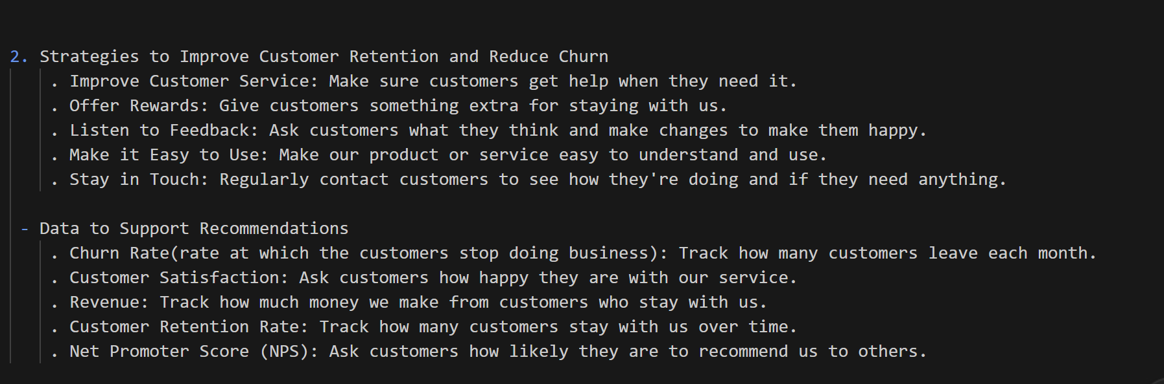

Slide 24
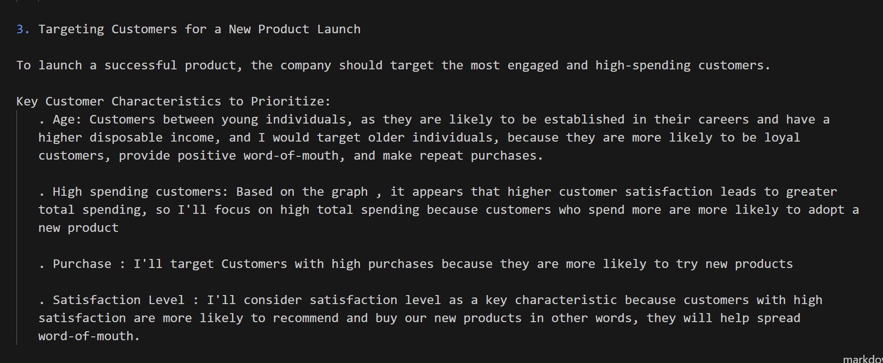

Slide 25
Group 2
Safeh Emmanuela Mnajoah
My superpower is unlocking insights from data. With a strong foundation in data analysis, I've developed skills in using Excel, Power BI, and Tableau to extract meaningful patterns and trends. Currently, in my second year of studying data science, I'm expanding my toolkit with programming languages like Python and R, and exploring machine learning and statistical modeling techniques. I'm passionate about leveraging data-driven insights to solve real-world problems and drive business growth
Soh David Fon

Slide 26

About us
As data science intern and traniee at Traitz Tech GO LTD, we've worked together on a project to analyze customer performance. We've studied the data, identified patterns, and come up with solutions to improve customer experience. We’ve successfully presented our project on 'Customer Performance', sharing our findings and insights to help businesses make informed decisions
Don’t forget your picture
Cause I know you want to put it.

Slide 27
The End
With love From Traitz Tech

